Slide 1
Model Performance and Insights

Slide 2
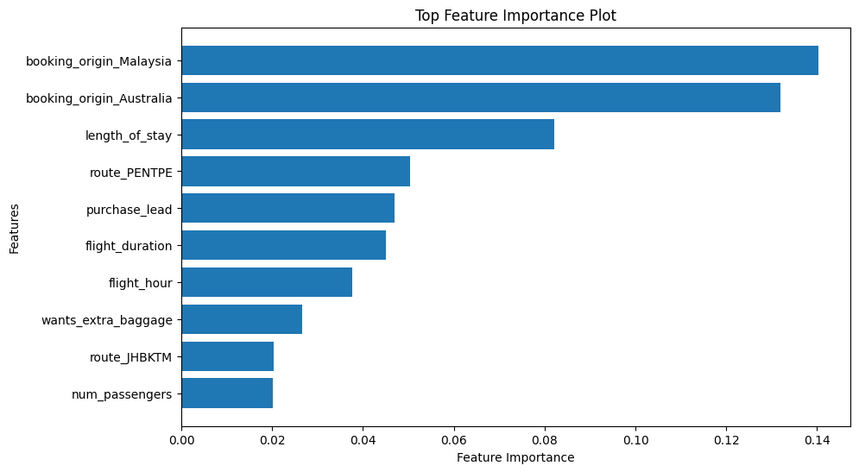
SUMMARY
Cross-Validation
Mean Accuracy: 0.850
Standard Deviation: 6.12e-05
Key Insights
The model achieved an accuracy of 0.852(85%), indicating good overall performance.
A standard deviation of 6.12e-05 means its small deviation, and very small standard deviation indicates that the model's performance is consistent across different subsets of the data.
The top contributing features to the model include booking_origin_Malaysia, booking_origin_Australia, length_of_stay, route_PENTPE, purchase_lead, flight_duration and flight_hour.

